Slide 1





Bry
Problem 7
Problem 6
Problem 5

Slide 2
10. Regular Expression Matching
String
DP
Recursive

Slide 3
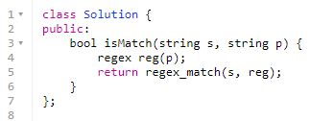
Regular Expression Matching
Easy function regex_match(string, reg)

Slide 4
Regular Expression Matching
DP - Dynamic Programming
Brute-force search
hardship in difficulty

Slide 5
Regular Expression Matching
Given an input string s and a pattern p, implement regular expression matching with support for '.' and '*' where:
'.' Matches any single character.​​​​
'*' Matches zero or more of the preceding element.
The matching should cover the entire input string (not partial).

Slide 6
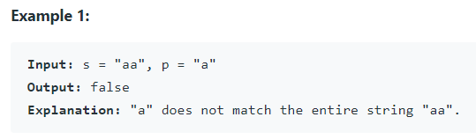
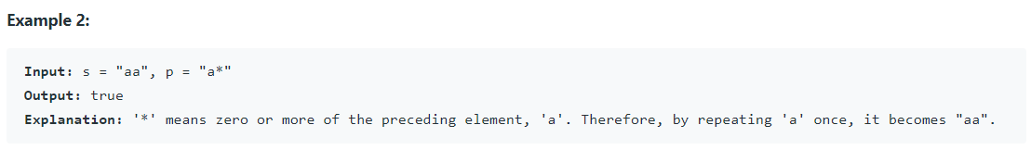
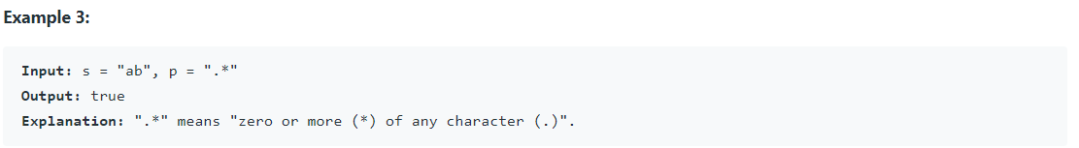
Regular Expression Matching

Slide 7
Regular Expression Matching
s = “aaa”
p = “a*a”

Slide 8
Regular Expression Matching
s = “aaa”
p = “a*a” while(“a*” && s[i] == ‘a’) ++i;

Slide 9
Regular Expression Matching
S = “aab”, P = “aac”

Slide 10
Regular Expression Matching
S = “aab”, P = “aac”
 | null | a | a | c
null
a
a
b

Slide 11
Regular Expression Matching
S = “aab”, P = “aac”
 | null | a | a | c
null | T
a
a
b

Slide 12
Regular Expression Matching
S = “aab”, P = “aac”
 | null | a | a | c
null | T | F
a
a
b

Slide 13
Regular Expression Matching
S = “aab”, P = “aac”
 | null | a | a | c
null | T | F | F | F
a
a
b

Slide 14
Regular Expression Matching
S = “aab”, P = “aac”
 | null | a | a | c
null | T | F | F | F
a | F
a
b

Slide 15
Regular Expression Matching
S = “aab”, P = “aac”
 | null | a | a | c
null | T | F | F | F
a | F
a | F
b | F

Slide 16
Regular Expression Matching
S = “aab”, P = “aac”
 | null | a | a | c
null | T | F | F | F
a | F | T
a | F
b | F

Slide 17
Regular Expression Matching
S = “aab”, P = “aac”
 | null | a | a | c
null | T | F | F | F
a | F | T | F
a | F
b | F

Slide 18
Regular Expression Matching
S = “aab”, P = “aac”
 | null | a | a | c
null | T | F | F | F
a | F | T | F | F
a | F
b | F

Slide 19
Regular Expression Matching
S = “aab”, P = “aac”
 | null | a | a | c
null | T | F | F | F
a | F | T | F | F
a | F | F
b | F

Slide 20
Regular Expression Matching
S = “aab”, P = “aac”
 | null | a | a | c
null | T | F | F | F
a | F | T | F | F
a | F | F | T
b | F

Slide 21
Regular Expression Matching
S = “aab”, P = “aac”
 | null | a | a | c
null | T | F | F | F
a | F | T | F | F
a | F | F | T | F
b | F

Slide 22
Regular Expression Matching
S = “aab”, P = “aac”
 | null | a | a | c
null | T | F | F | F
a | F | T | F | F
a | F | F | T | F
b | F | F

Slide 23
Regular Expression Matching
S = “aab”, P = “aac”
 | null | a | a | c
null | T | F | F | F
a | F | T | F | F
a | F | F | T | F
b | F | F | F

Slide 24
Regular Expression Matching
S = “aab”, P = “aac”
 | null | a | a | c
null | T | F | F | F
a | F | T | F | F
a | F | F | T | F
b | F | F | F | F

Slide 25
Regular Expression Matching
S = “aab”, P = “aac”
 | null | a | a | c
null | T | F | F | F
a | F | T | F | F
a | F | F | T | F
b | F | F | F | F

Slide 26
Regular Expression Matching
S = “aab”, P = “aac” if(s[i] = p[j]) ar[i][j] == ar[i-1][j-1];
 | null | a | a | c
null | T | F | F | F
a | F | T | F | F
a | F | F | T | F
b | F | F | F | F

Slide 27
Regular Expression Matching
S = “abbbc”, P = “b*ab*c”

Slide 28
Regular Expression Matching
S = “abbbc”, P = “b*ab*c”
 | Null | b | * | a | b | * | c
Null | T
a
b
b
b
c

Slide 29
Regular Expression Matching
S = “abbbc”, P = “b*ab*c”
 | Null | b | * | a | b | * | c
Null | T | F
a
b
b
b
c

Slide 30
Regular Expression Matching
S = “abbbc”, P = “b*ab*c”
 | Null | b | * | a | b | * | c
Null | T | F | T
a
b
b
b
c

Slide 31
Regular Expression Matching
S = “abbbc”, P = “b*ab*c”
 | Null | b | * | a | b | * | c
Null | T | F | T | F
a
b
b
b
c

Slide 32
Regular Expression Matching
S = “abbbc”, P = “b*ab*c”
 | Null | b | * | a | b | * | c
Null | T | F | T | F | F | F | F
a
b
b
b
c

Slide 33
Regular Expression Matching
S = “abbbc”, P = “b*ab*c”
 | Null | b | * | a | b | * | c
Null | T | F | T | F | F | F | F
a | F
b | F
b | F
b | F
c | F

Slide 34
Regular Expression Matching
S = “abbbc”, P = “b*ab*c”
 | Null | b | * | a | b | * | c
Null | T | F | T | F | F | F | F
a | F | F
b | F
b | F
b | F
c | F

Slide 35
Regular Expression Matching
S = “abbbc”, P = “b*ab*c”
 | Null | b | * | a | b | * | c
Null | T | F | T | F | F | F | F
a | F | F | F
b | F
b | F
b | F
c | F

Slide 36
Regular Expression Matching
S = “abbbc”, P = “b*ab*c”
 | Null | b | * | a | b | * | c
Null | T | F | T | F | F | F | F
a | F | F | F | T
b | F
b | F
b | F
c | F

Slide 37
Regular Expression Matching
S = “abbbc”, P = “b*ab*c”
 | Null | b | * | a | b | * | c
Null | T | F | T | F | F | F | F
a | F | F | F | T | F
b | F
b | F
b | F
c | F

Slide 38
Regular Expression Matching
S = “abbbc”, P = “b*ab*c”
 | Null | b | * | a | b | * | c
Null | T | F | T | F | F | F | F
a | F | F | F | T | F | T
b | F
b | F
b | F
c | F

Slide 39
Regular Expression Matching
S = “abbbc”, P = “b*ab*c”
 | Null | b | * | a | b | * | c
Null | T | F | T | F | F | F | F
a | F | F | F | T | F | T | F
b | F | T
b | F
b | F
c | F

Slide 40
Regular Expression Matching

Slide 41
Regular Expression Matching

Slide 42
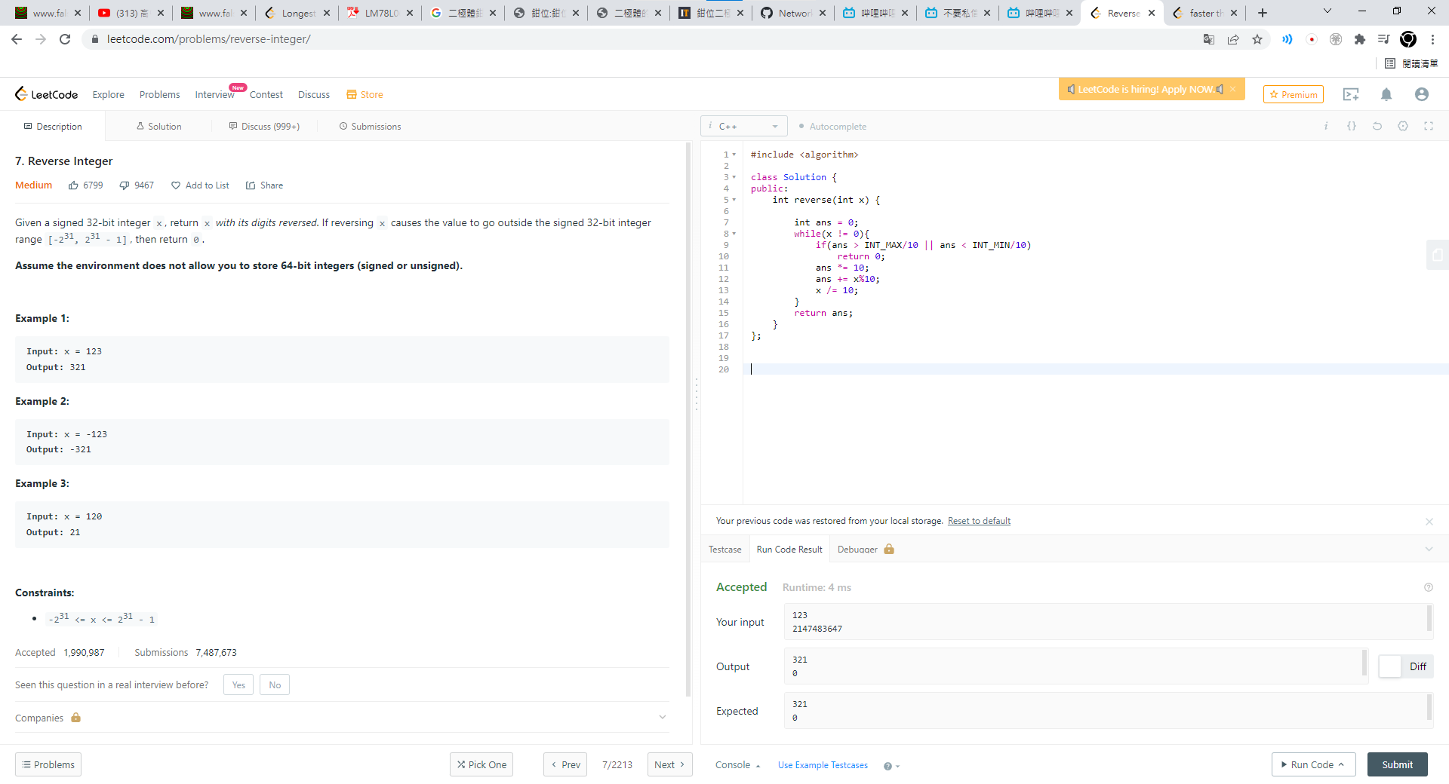
Reverse Integer
If input is 123
X :
Ans :
123
0

Slide 43
Reverse Integer
If input is 123
X :
Ans :
123
0

Slide 44
Reverse Integer
If input is 123
X :
Ans :
123
0

Slide 45
Reverse Integer
If input is 123
X :
Ans :
123
3

Slide 46
Reverse Integer
If input is 123
X :
Ans :
123
3

Slide 47
Reverse Integer
If input is 123
X :
Ans :
12
3

Slide 48
Reverse Integer
If input is 123
X :
Ans :
ans *= 10
12
3

Slide 49
Reverse Integer
If input is 123
X :
Ans :
ans *= 10
12
30

Slide 50
Reverse Integer
If input is 123
X :
Ans :
ans += x%10
12
32

Slide 51
Reverse Integer
If input is 123
X :
Ans :
X /= 10
1
32

Slide 52
Reverse Integer
If input is 123
X :
Ans :
0
321

Slide 53
Reverse Integer
INT_MAX is 2147483647
Reverse is 7463847412
It is bigger than INT
So only need to judge 21xxx
If x = 21xxx
Reverse will be xx12
INT_MAX 1’th digits is 7

Slide 54
6. Zigzag Conversion
String

Slide 55
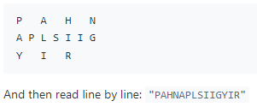
Zigzag Conversion
The string "PAYPALISHIRING" is written in a zigzag pattern on a given number of rows like this: (you may want to display this pattern in a fixed font for better legibility)

Slide 56
Zigzag Conversion
The string "PAYPALISHIRING" is written in a zigzag pattern on a given number of rows like this: (you may want to display this pattern in a fixed font for better legibility)

Slide 57
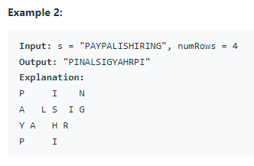
Zigzag Conversion
The string "PAYPALISHIRING" is written in a zigzag pattern on a given number of rows like this: (you may want to display this pattern in a fixed font for better legibility)

Slide 58
Zigzag Conversion
The string "PAYPALISHIRING" is written in a zigzag pattern on a given number of rows like this: (you may want to display this pattern in a fixed font for better legibility)

Slide 59
Zigzag Conversion
The string "PAYPALISHIRING" is written in a zigzag pattern on a given number of rows like this: (you may want to display this pattern in a fixed font for better legibility)

Slide 60
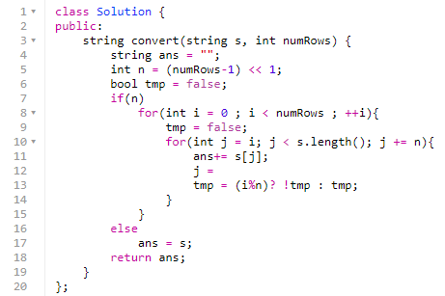
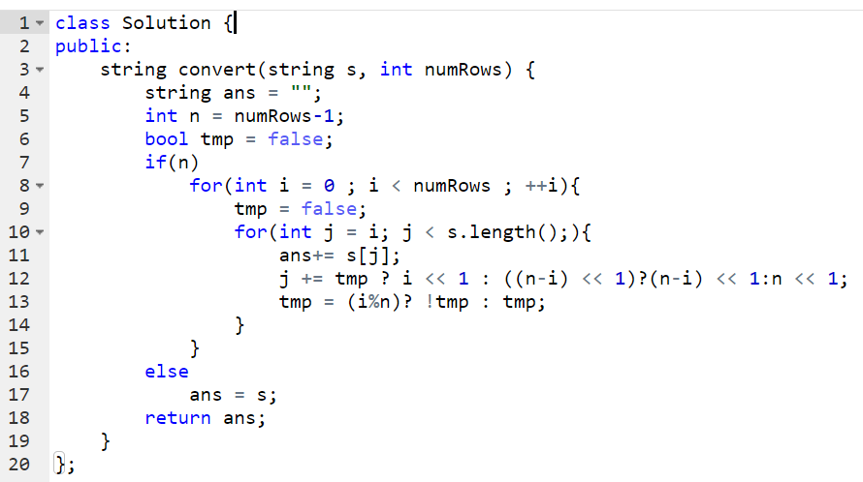
Zigzag Conversion

Slide 64
5. Longest Palindromic Substring
Given a string s, return the longest palindromic substring in s.
Example 1:
Input: s = "babad"
Output: "bab"
Explanation: "aba" is also a valid answer.
Example 2:
Input: s = "cbbd" Output: "bb"
String
Dynamic Programming

Slide 65
P5
Topic
副標題
String
Dynamic Programming
開啟 [設計構想] 窗格即時美化投影片。
當我們有設計構想時，就會在這裡將它們展示給您。
Notes:
(這些沒有設計者識別碼，因為基於預設的投影片母片已存在於投影片組中。

Slide 66
筆刷
簡報者姓名

Slide 67
議程
使用 PowerPoint，您可以隨時隨地建立簡報並與其他人分享。在此處輸入任何文字以開始使用。您也可以在這個範本上新增影像、美工圖案和影片。儲存到 OneDrive 並從電腦、平板電腦或手機存取您的簡報。

Slide 68


主題一
副標題

Slide 69
圖表

Slide 70
表格
 | 類別 1 | 類別 2 | 類別 3 | 類別 4
項目 1 | 4.5 | 2.3 | 1.7 | 5
項目 2 | 3.2 | 5.1 | 4.4 | 3
項目 3 | 2.1 | 1.7 | 2.5 | 2.8
項目 4 | 4.5 | 2.2 | 1.7 | 7

Slide 71
想要讓事情有個起頭，只要停止說話，然後開始做事就好了。
Walt Disney

Slide 72





小組
姓名
姓名
姓名
姓名
姓名
職稱
職稱
職稱
職稱
職稱

Slide 73
時間表
職稱
若要開始簡報，請移至 [投影片放映] 索引標籤，然後選取 [從首張​​投影片​​]。
職稱
若要顯示 [簡報者檢視畫面]，請在 [投影片放映] 檢視左下方的控制列上選取三個點，然後選取 [顯示簡報者檢視畫面]。
職稱
簡報期間，演講者備忘稿會顯示在監視器上，但觀眾看不到。
職稱
[備忘稿] 窗格是一個顯示在每張投影片下面的方塊。點一下它來新增備忘稿。
職稱
如果找不到 [備忘稿] 窗格或它已縮到最小，請按一下 PowerPoint 視窗底部工作列上的 [備忘稿]。

Slide 74
內容
副標題
副標題
新增文字、影像、美工圖案和影片。
新增轉場效果、動畫和動態效果。
儲存至 OneDrive 以便從電腦、平板電腦或手機存取您的簡報。
開啟 [設計構想] 窗格即時美化投影片。
當我們有設計構想時，就會在這裡將它們展示給您。
Notes:
(這些沒有設計者識別碼，因為基於預設的投影片母片已存在於投影片組中。

Slide 75
內容
副標題
副標題
副標題
新增文字、影像、美工圖案和影片。
新增轉場效果、動畫和動態效果。
儲存至 OneDrive 以便從電腦、平板電腦或手機存取您的簡報。
開啟 [設計構想] 窗格即時美化投影片。
當我們有設計構想時，就會在這裡將它們展示給您。
這個 PowerPoint 主題使用它自己獨特的一套色彩、字型和效果來打造這些投影片的整體外觀和感覺。
PowerPoint 有大量的主題，可以讓您的簡報更具個人風格。

Slide 76


摘要
使用 PowerPoint，您可以隨時隨地建立簡報並與他人分享您的作品。在此處輸入任何文字以開始使用。您也可以在這個範本上新增影像、美工圖案和影片。儲存到 OneDrive 並從電腦、平板電腦或手機存取您的簡報。

Slide 77


感謝您
簡報者姓名
電子郵件地址
網站

